Slide 1
Steganography: (Hiding Information in Image )
CAPSTONE PROJECT
Presented By:
Student Name- Jyothula Harshitha
College Name- Gayathri Vidhya Parishad engineering College for women's
Department- ECE

Slide 2
OUTLINE
Problem Statement (Should not include solution)
System Development Approach (Technology Used)
Algorithm & Deployment (Step by Step Procedure)
Result
Conclusion
Future Scope(Optonal)
References

Slide 3
Problem Statement
Steganography is a technique of hiding confidential data within other non-secret files, such as images, to protect it from unauthorized access. With the rise in digital communication, the need for secure and private information sharing is more crucial than ever. Traditional encryption draws attention to the existence of a secret message, whereas steganography conceals it entirely. Our project focuses on hiding an image inside another image using steganographic techniques. This helps in securely transferring the hidden image without raising suspicion, providing an additional layer of security.

Slide 4
System Approach
The "System Approach" section outlines the overall strategy and methodology for developing and implementing. Here's a suggested structure for this section:
System requirements:- A computer system with Python installed, along with image processing libraries such as OpenCV, NumPy, and PIL.
Library required to build the model:- Python libraries like cv2,numpy and matplotlib we are using for encodeing and decoding images

Slide 5
Algorithm & Deployment
Here is the step-by-step procedure followed to complete this project:-
Load both the cover image (image to be shown) and the secret image (image to be hidden).
Convert the images into arrays and prepare them for bit-level manipulation.
Apply the Least Significant Bit (LSB) encoding by replacing the least significant bits of the cover image with the most significant bits of the secret image.
Merge and save the stego image.
For decoding, reverse the process to retrieve the hidden image from the stego image.
Display the decoded image and verify accuracy.
Deploy the code in a user-friendly Python script or notebook, optionally with GUI.

Slide 6
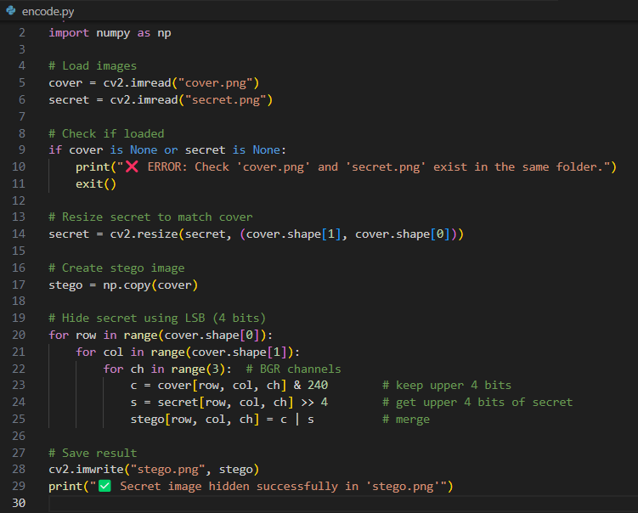
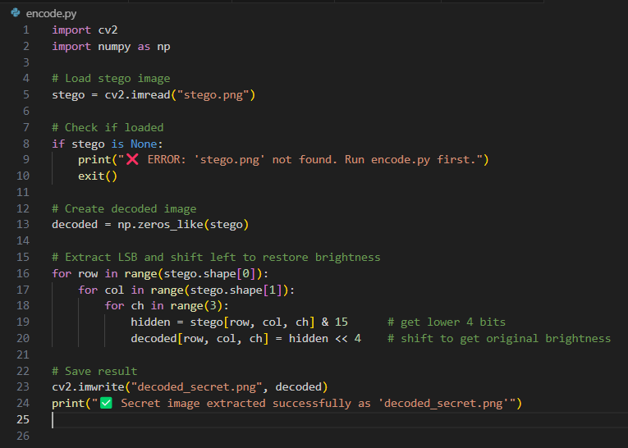
Result
1. Code: Encoding
2. Code: Decoding

Slide 7


Result
3. Cover Image
4.Stego Image
5. Decoded Image
Attach your Github link:-
https://github.com/HarshithaJyothula

Slide 8
Conclusion
In this project, we successfully demonstrated how steganography can be used to hide an image inside another image using the Least Significant Bit technique. The results showed that the stego image retained high visual similarity with the original cover image, while securely embedding the secret image. We encountered challenges in image size compatibility and data overflow, which were handled using size constraints. The solution proves to be efficient for basic image-based steganography and can be enhanced for larger-scale or multi-layered data hiding.

Slide 9
Future scope(Optional)
Future improvements can include:-
Implementation of more advanced steganographic methods like DCT or DWT.
Integration with encryption for double-layer security.
Creating a full-fledged GUI application for user interaction.
Supporting different types of media such as audio or video steganography.

Slide 10
References
Research papers on LSB Steganography techniques.
Official Python documentation.
Online tutorials and GitHub repositories on image steganography.
Books on digital image processing and security.

Slide 11
THANK YOU

